Slide 1

A S T A
- Automatically Sleep Terminate Assistant -
Digital Control Systems Technology
Faculty of Technology
University of Sri Jayewardenepura
2023 . 06 .15

Slide 2
TABLE OF CONTENTS
01
PROJECT OVERVIEW
BLOCK DESIGN
COMPONENTS
CONSTRUCTION & TESTING
02
03
CIRCUIT DIAGRAM
04
05

Slide 3
PROJECT OVERVIEW
The goal of this project is to develop a system that can accurately detect sleepy driving and make alarms accordingly, which aims to prevent the drivers from drowsy driving and create a safer driving environment.
The project was accomplished by a Webcam that constantly takes image of driver, a beagle board that implement image processing algorithm of sleepy detection, and a feedback circuit that could generate alarm and a power supply system.

Slide 4
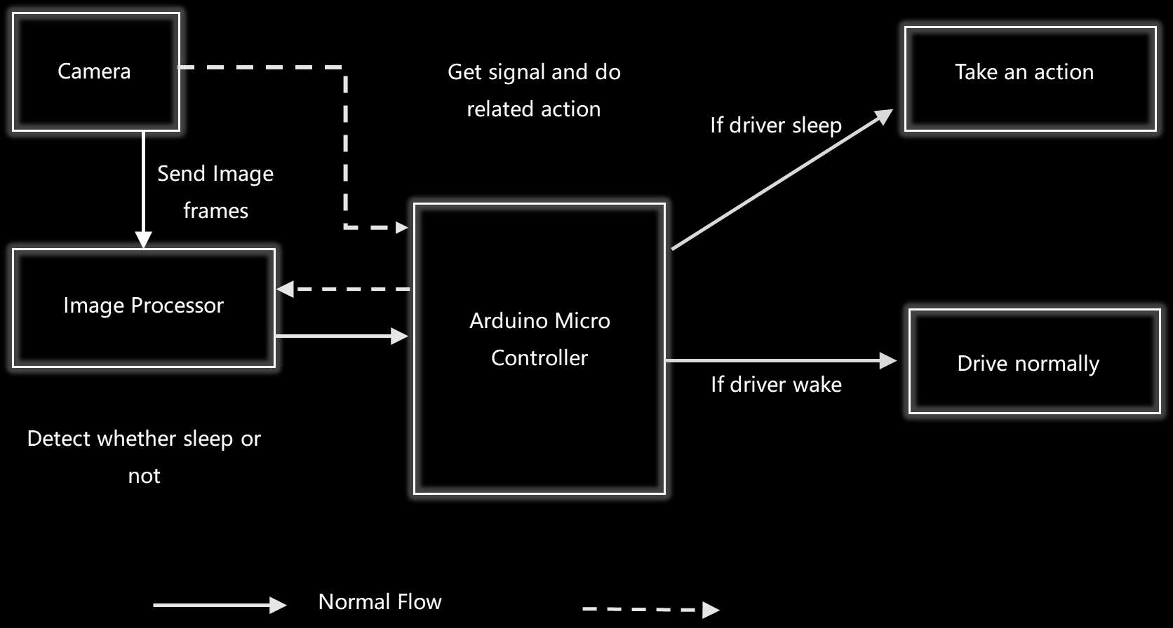
BLOCK DIAGRAM

Slide 5
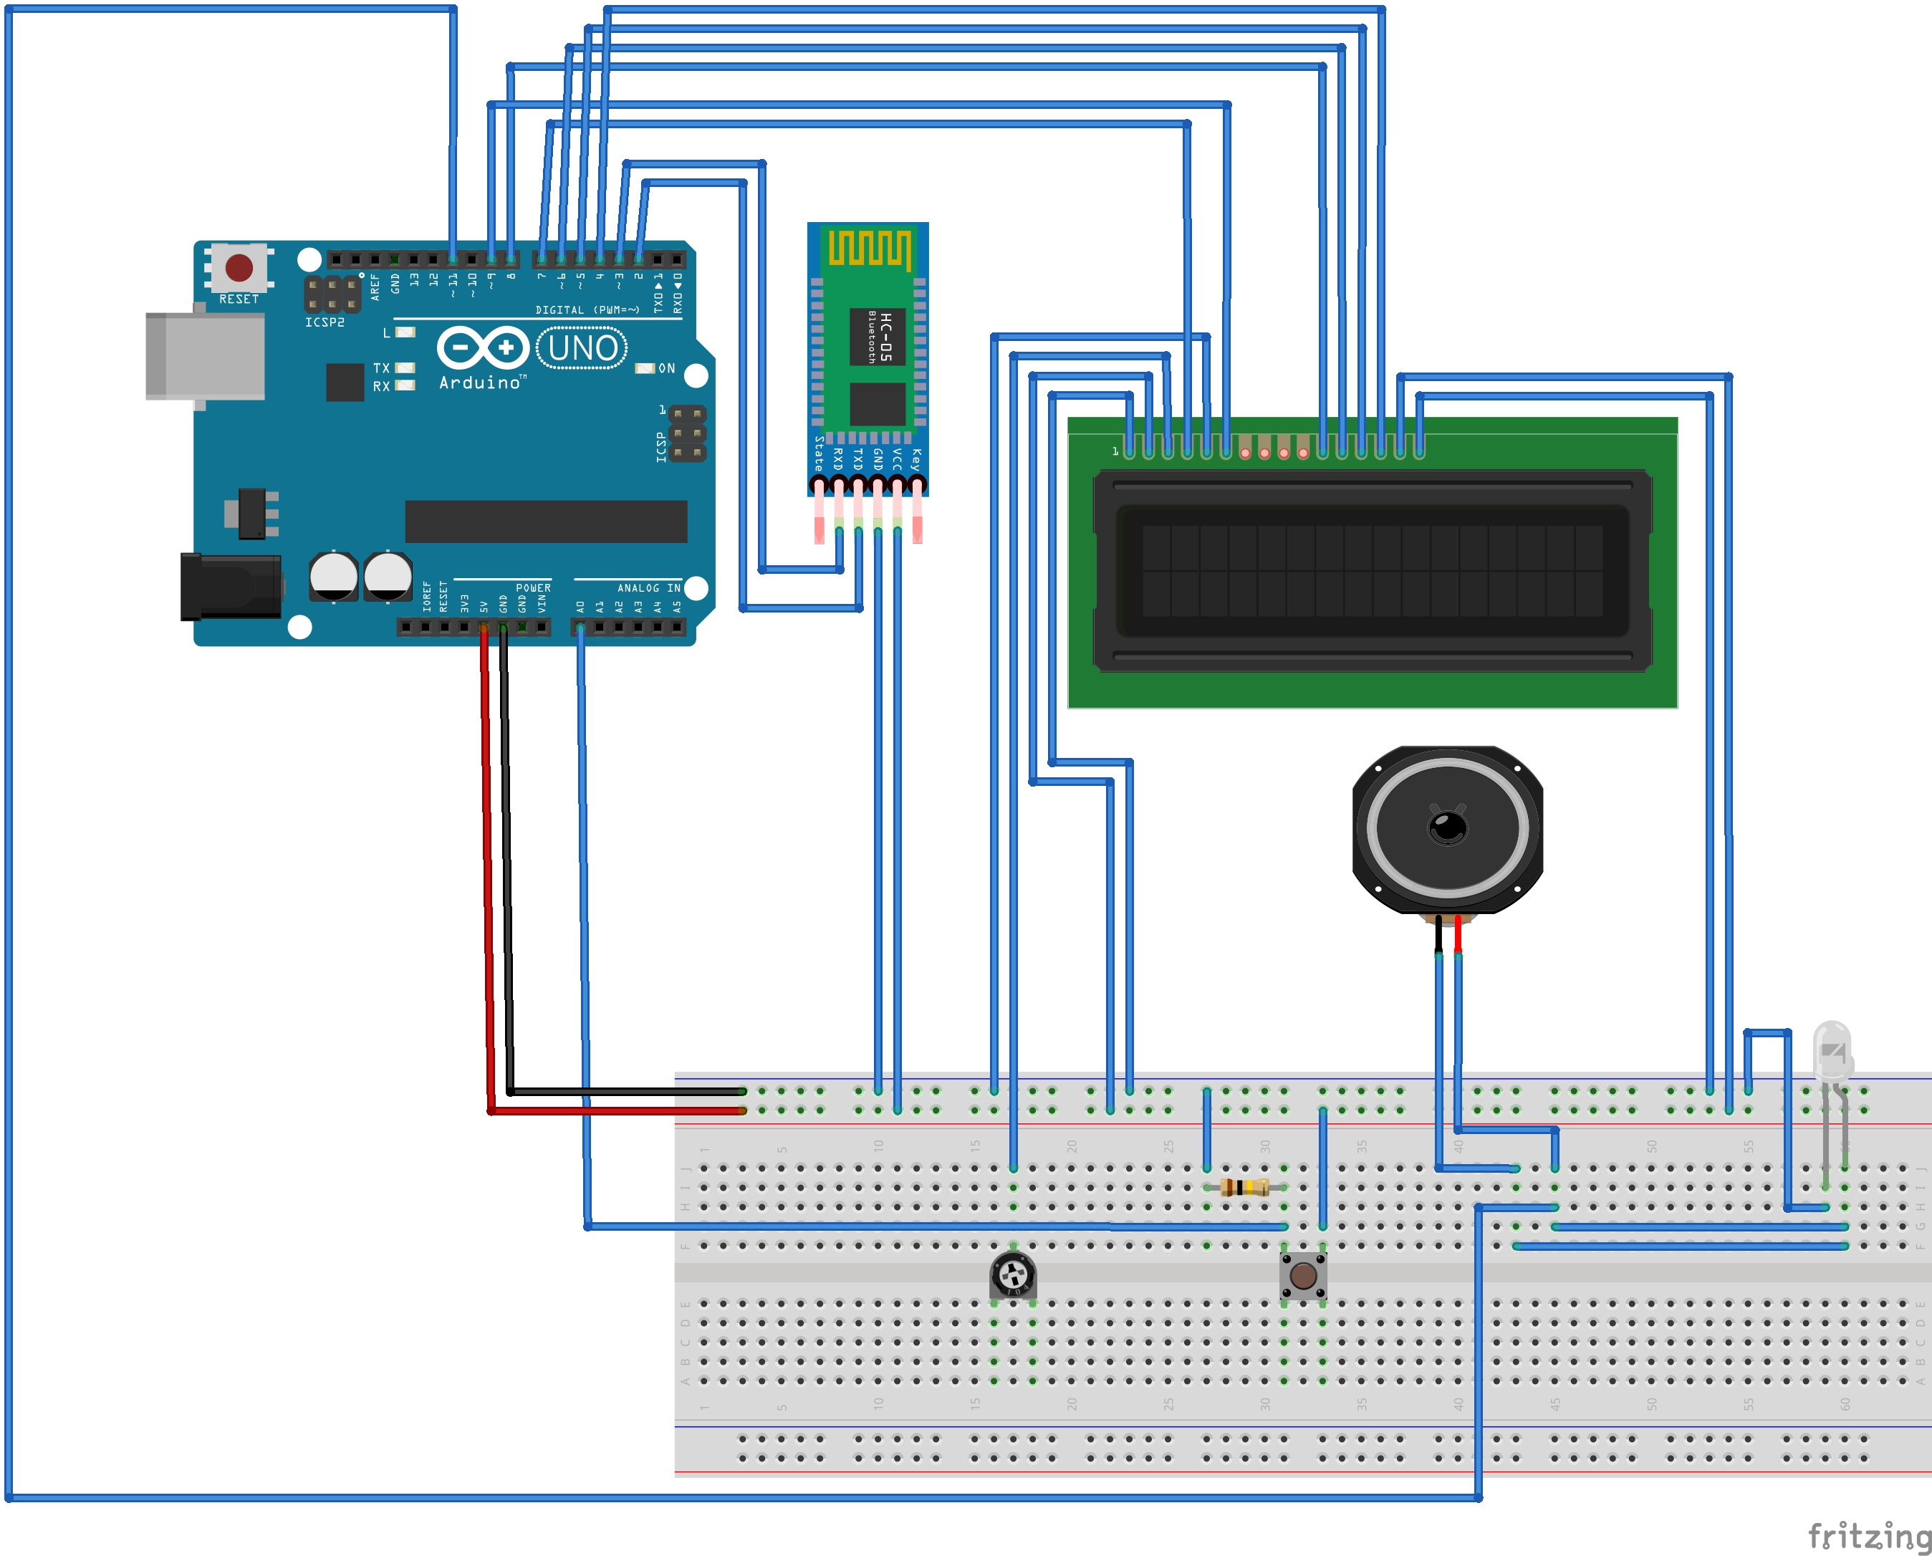
CIRCUIT DIAGRAM

Slide 6
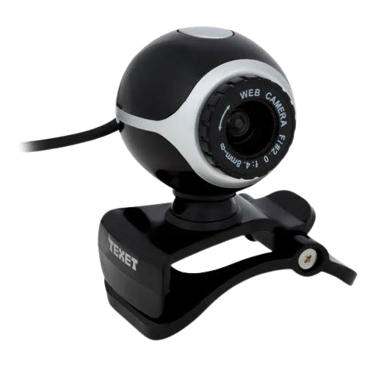
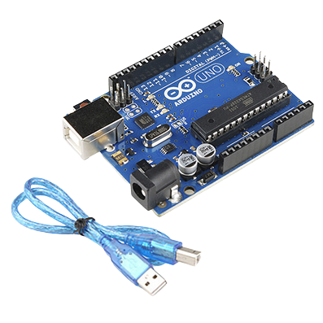
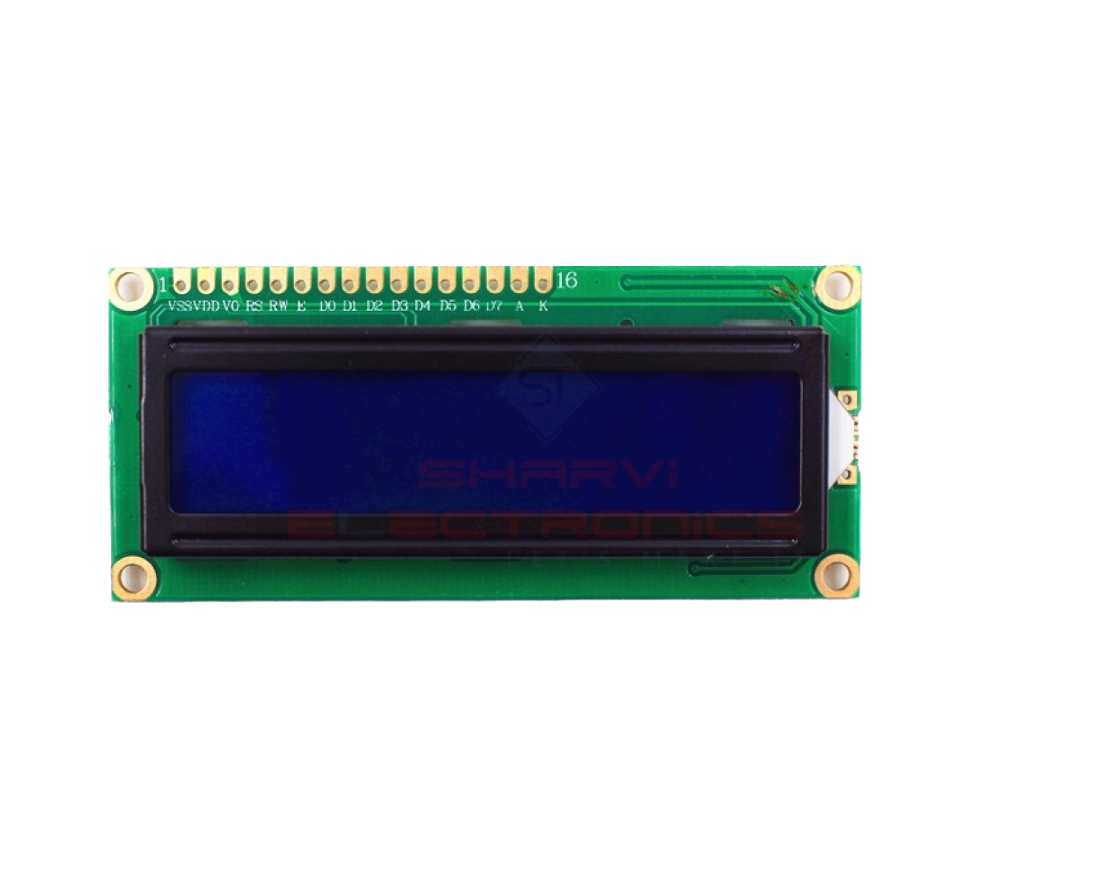
Hardware COMPONENTS
WEB CAMERA
AEDUINO UNO
( 16 x 2 ) LCD Display

Slide 7
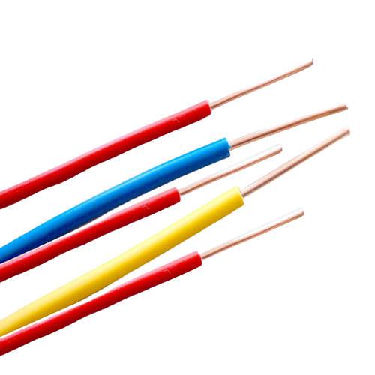
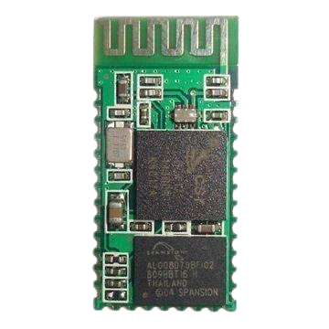
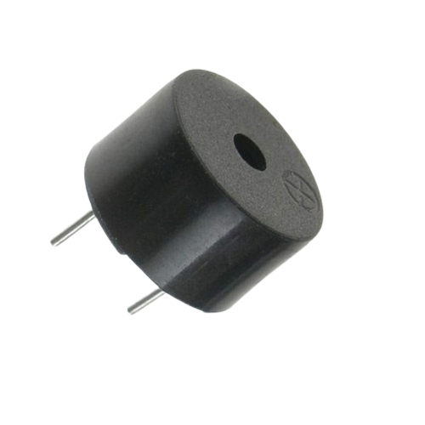
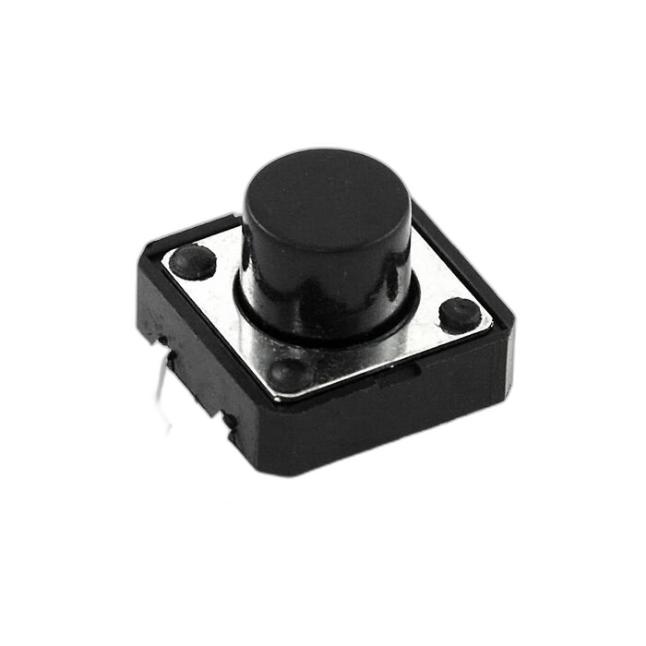
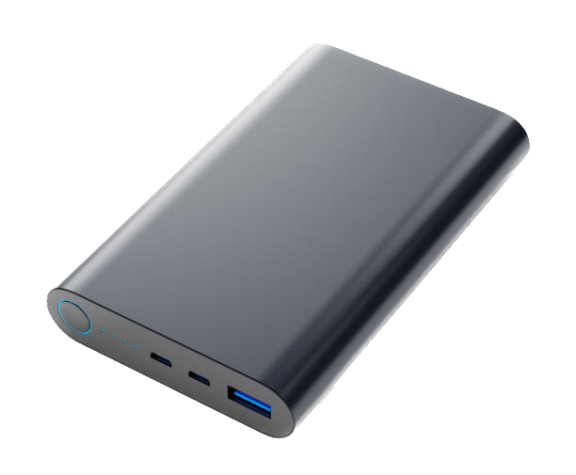
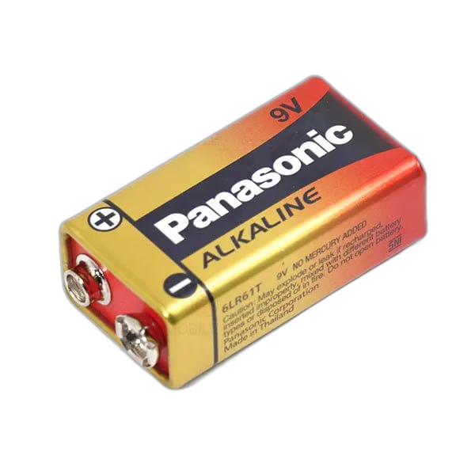
Hardware COMPONENTS
HC-03 Bluetooth Model
Buzzer
Wires
Battery & Power Supply
Push Button Switch

Slide 8
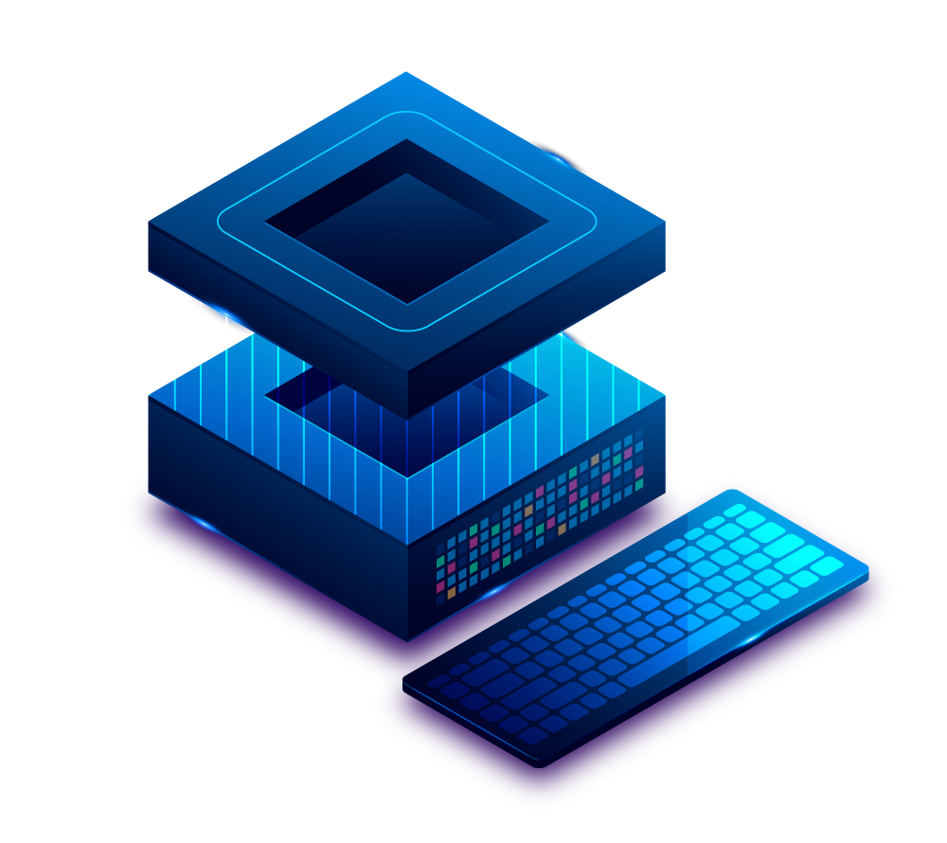



COMPONENTS
Hardware manipulation
Build front-end interface
Back-end works
Image processing
Python
Image processing library

Slide 9
CONSTRUCTION & TESTING
import cv2
import serial
import time
# Config the arduino
# ArduinoSerial = serial.Serial('COM8', 9600, timeout=1)
ArduinoSerial=serial.Serial('COM4', 9600, timeout=1) #Start communications with the bluetooth unit
face_cascade = cv2.CascadeClassifier('open/cascadeFace.xml')
eye_cascade = cv2.CascadeClassifier('open/eyeGlass.xml')
cap = cv2.VideoCapture(0)
while cap.isOpened():
time.sleep(0.5)
key = 0
ret, frame = cap.read()
gray = cv2.cvtColor(frame, cv2.COLOR_BGR2GRAY)
faces = face_cascade.detectMultiScale(
frame,
scaleFactor = 1.1,
minNeighbors = 6,
minSize = (350, 350)
)
for x, y, w, h in faces:
cv2.rectangle(frame, (x, y), (x + w, y + h), (0, 0, 255), 3)
face = frame[y:y + h, x:x + w]
eyes = eye_cascade.detectMultiScale(
face,
scaleFactor = 1.1,
minNeighbors = 6
)
for x2, y2, w2, h2 in eyes:
cv2.rectangle(face, (x2, y2), (x2 + w2, y2 + h2), (0, 255, 0), 3)
key = 1
cv2.imshow('img', frame)
if cv2.waitKey(10) & 0xFF == ord('q'):
break
print(key)
cnvKey = str(key)
ArduinoSerial.write(cnvKey.encode('utf-8'))
cap.release()
cv2.destroyAllWindows()
Python

Slide 10
CONSTRUCTION & TESTING
#include "SoftwareSerial.h"
#include <LiquidCrystal.h>
const int rs = 7, en = 9, d4 = 8, d5 = 6, d6 = 5, d7 = 4;
LiquidCrystal lcd(rs, en, d4, d5, d6, d7);
SoftwareSerial serial_connection(2, 3);//Create a serial connection with TX and RX on these pins
int led_pin = 11;
#define switch A0
char inChar=-1;//Initialie the first character as nothing
int count =0;
void setup()
{
lcd.begin(16, 2);
pinMode(11, OUTPUT);
Serial.begin(9600);//Initialize communications to the serial monitor in the Arduino IDE
Serial.println("Started");//Tell the serial monitor that the sketch has started.
lcd.setCursor(1 , 0 );
lcd.print("Project ASTA");
delay(1000);
}
void loop()
{
byte byte_count=serial_connection.available();//This gets the number of bytes that were sent by the python script
if(byte_count)//If there are any bytes then deal with them
{
Serial.println("Incoming Data");//Signal to the monitor that something is happening
inChar=serial_connection.read();//Read one byte
while(inChar == '1'){
digitalWrite(led_pin,LOW);
clr(2);
lcd.setCursor(1 , 1 );
lcd.print("Drive Safe");
// delay(1000);
inChar=serial_connection.read();//Read one byte
while(inChar != '1' && count < 10){
inChar=serial_connection.read();//Read one byte
delay(200);
count++;
Serial.println(count);
}
count = 0;
}
Serial.println(inChar);//Print to the monitor what was detected
}
while (1){
digitalWrite(led_pin, HIGH);
clr(2);
lcd.setCursor(1 , 1 );
lcd.print("SLEEP WARNING!");
int val = digitalRead(switch);
delay(20);
if(val == HIGH)
break;
}
}
void clr(int x) {
lcd.setCursor(7, x-1);
lcd.setCursor(0,x-1);
lcd.print(" ");
}

Slide 11
CONSTRUCTION & TESTING

Slide 12
BUDGET
360.00
Name | Price (Rs:)
Arduino UNO | 2,950.00
Bluetooth Module ( HC-05 ) | 950.00
( 16 x 2 ) Blue Backlight LCD Display | 700.00
Project Board ( Breadboard Solderless ) | 360.00
Jumper wire ( Male-to-Male ) | 240.00
Battery ( 9V ) | 180.00
Glue Sticks ( Small ) | 70.00
Mini Buzzer ( 5V ) | 60.00
Potentiometer (10K ) | 30.00
Push on Switch ( 4-pin ) | 20.00
NPN Transistor (D400 ) | 20.00
LED ( 5mm White ) | 10.00
Resistors [ 100k ( Kilo ohm ) ] | 2.00
Total | 5592.00

Slide 13
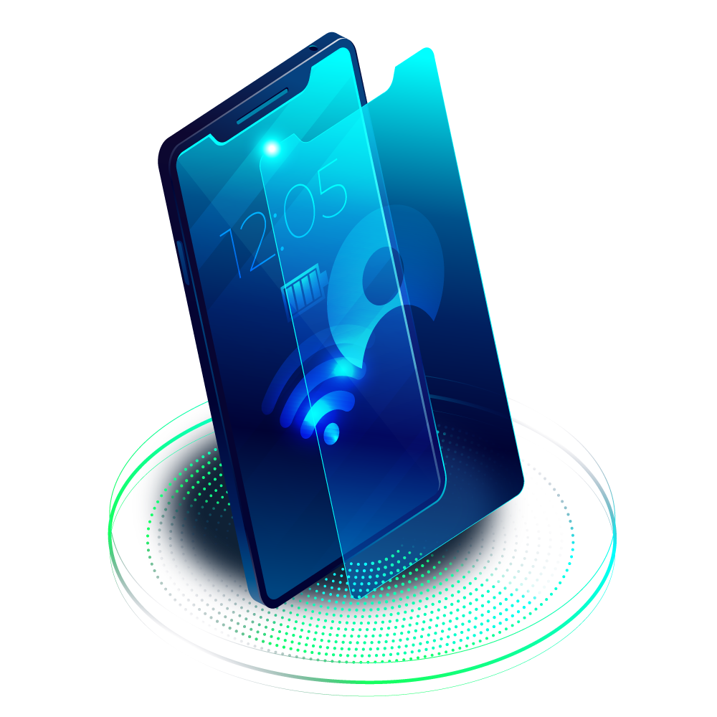
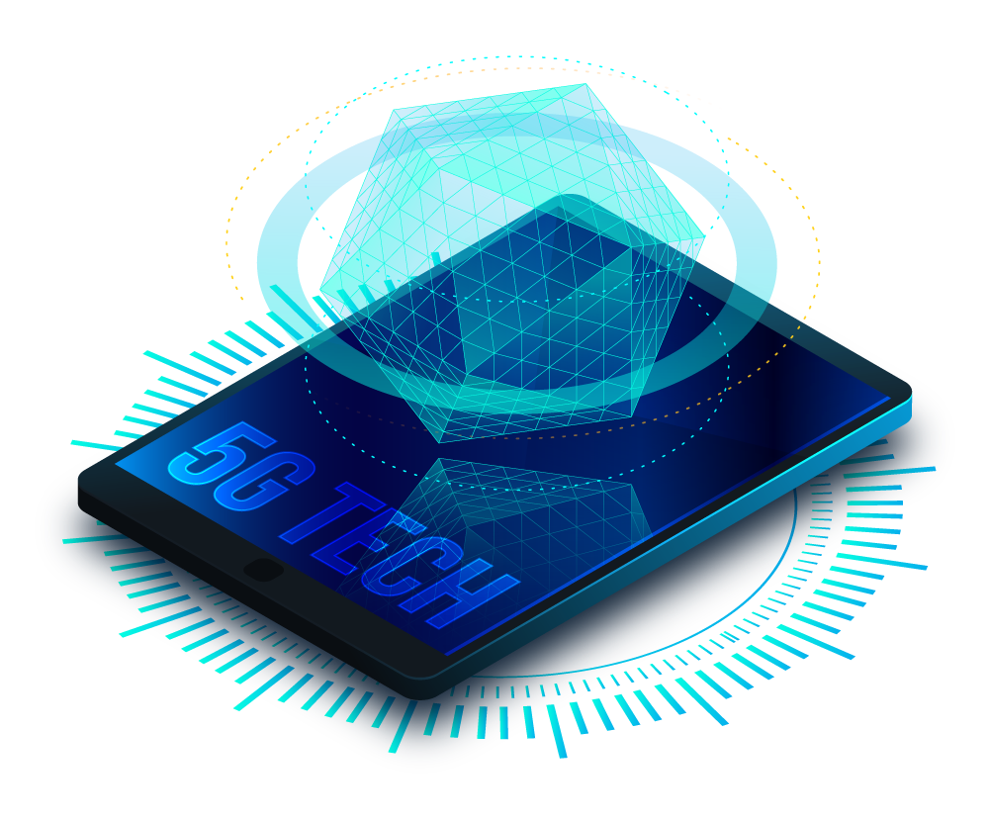

RESOURCES
OpenCV – Documentation
https://docs.opencv.org/4.x/
GitHub – Repository
https://github.com/GeekyShiva/OpenCV-miniProject-FaceDetection
Arduino – Documentation
https://www.arduino.cc/en/Guide
Sackoverflow - Forums
https://stackoverflow.com

Slide 14
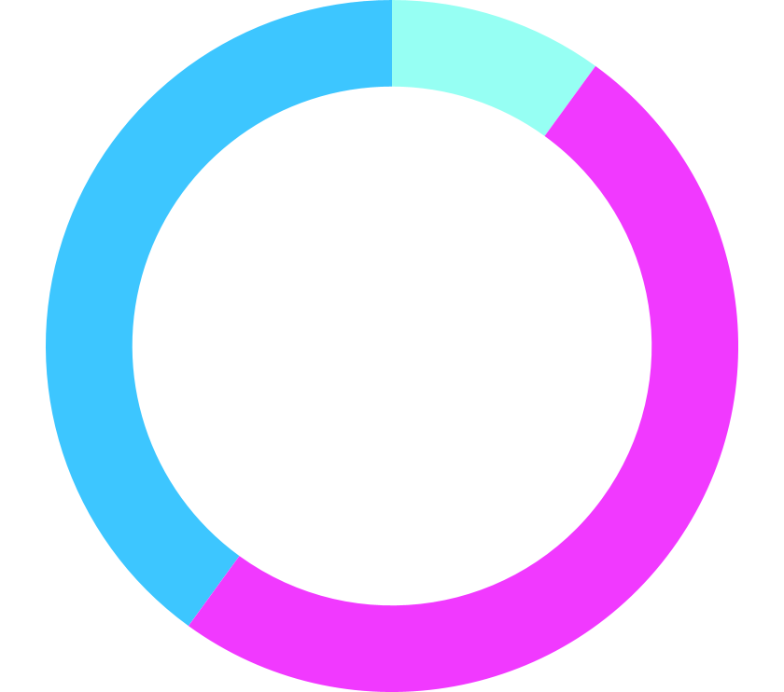
PROJECT PERFORMANCE
10%
SPEED
40%
EFFICIENCY
50%
PREDICTION
Mercury is the closest planet to the Sun and the smallest of them all
Venus has a beautiful name and is the second planet from the Sun
Follow the link in the graph to modify its data and then paste the new one here. For more info, click here
Mars is full of iron oxide dust, which gives the planet its reddish cast

Slide 15
The TEAM
Mudara Manaruchira - ICT/20/886
Asitha Lakmal - ICT/20/935
Nusrath Suhaila-ICT/20/942
Chathuka Bimsara-ICT20/815
Yasasi Ravihansi - ICT/20/812
Fathima Faazath - ICT/20/839
Shavindu T. Sampath - ICT/20/923
Fathima Rustha - Ict/20/920

Slide 16
THANK YOU

